Slide 1


WELCOME

Slide 2
Teachers identifications:
Biplab Bikash Tripura
Assistant Teacher
Taitong Para Govt. Primary School
Rajasthali,Rangamati.
E-mail : bbtripura@gmail.com

Slide 3
Class : Two
Sub : English
Time : 35 minites

Slide 4
Alphabet (Aa-Dd )
Lesson-3
At page 9

Slide 5
Learning outcomes:
Students will be able to –
(1)Know about Aa-Dd.
(2)Say Aa-Dd with correctly.
(3)Know and say 2 words with every alphabet Aa-Dd.

Slide 6

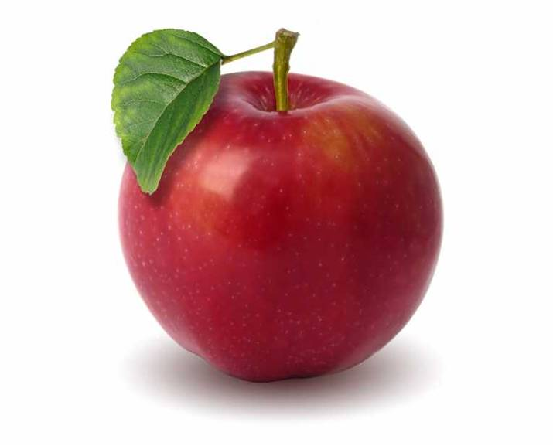
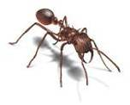
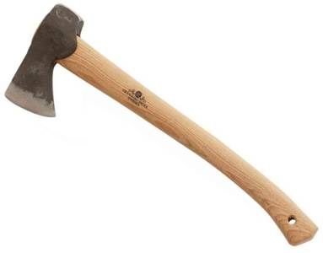
Look at the picture
A
Apple
Ant
Axe

Slide 7


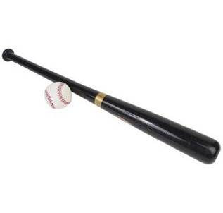
Look at the picture
B
Ball
Bat

Slide 8
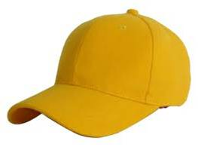
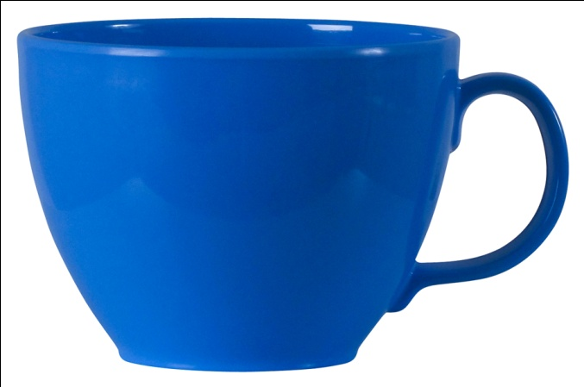

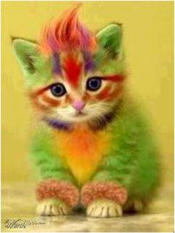
Look at the picture
C
Cap
Cup
Cat

Slide 9
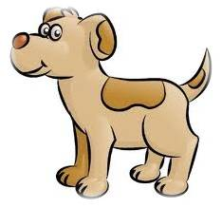
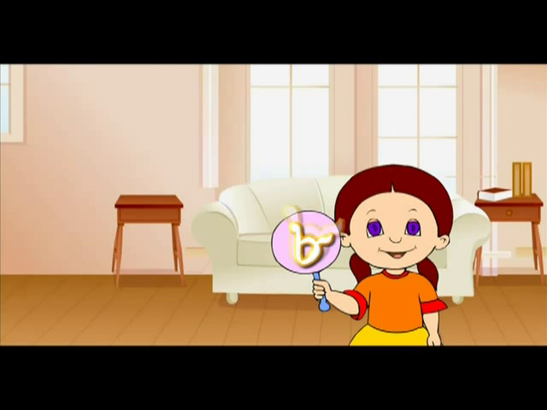

Look at the picture
D
Dog
Doll

Slide 10
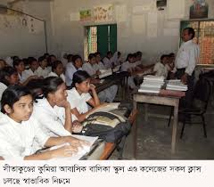
Teachers and students reading :

Slide 11
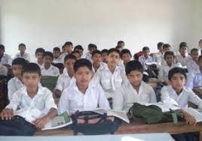
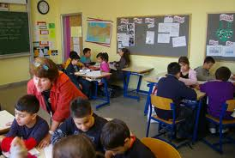
Students reading(group &individual)

Slide 12
Match the capital and small letters:
A
B
C
D
C
a
d
b

Slide 13



Match with alphabet and picture:
a
b
c
d

Slide 14
THANKS
To All.

